Slide 1
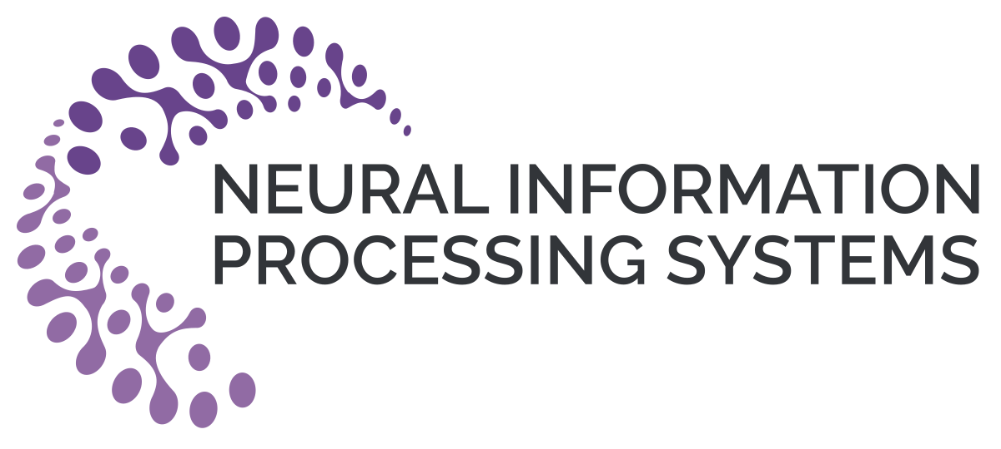
Iterative Deep Graph Learning for Graph Neural Networks: Better and Robust Node Embeddings
Yu Chen
Rensselaer Polytechnic Institute
hugochan2013@gmail.com
Lingfei Wu
IBM Research
lwu@email.wm.edu
Mohammed J. Zaki
Rensselaer Polytechnic Institute
zaki@cs.rpi.edu

Slide 2
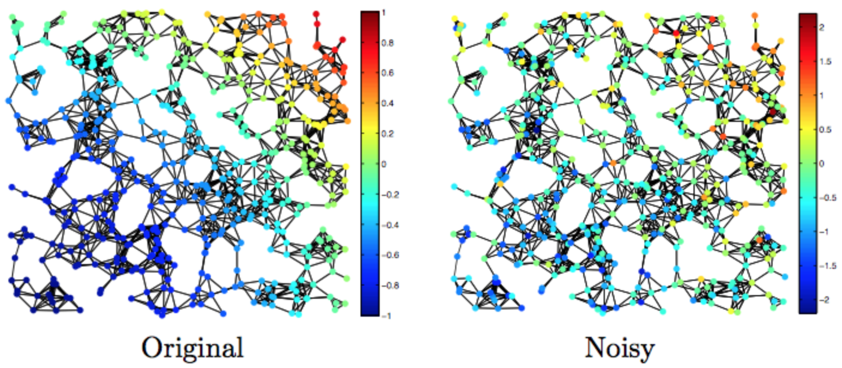
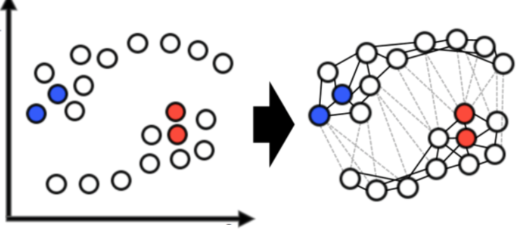
Motivation
GNNs are powerful, unfortunately, it requires graph-structured data available.
Questionable if the given intrinsic graph-structures are optimal (i.e., noisy, incomplete, etc.) for the downstream tasks.
Many applications (e.g., NLP tasks) may only have non-graph structured data or even just the original feature matrix, requiring additional graph construction.

Slide 3
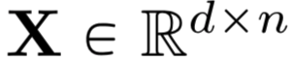
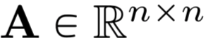
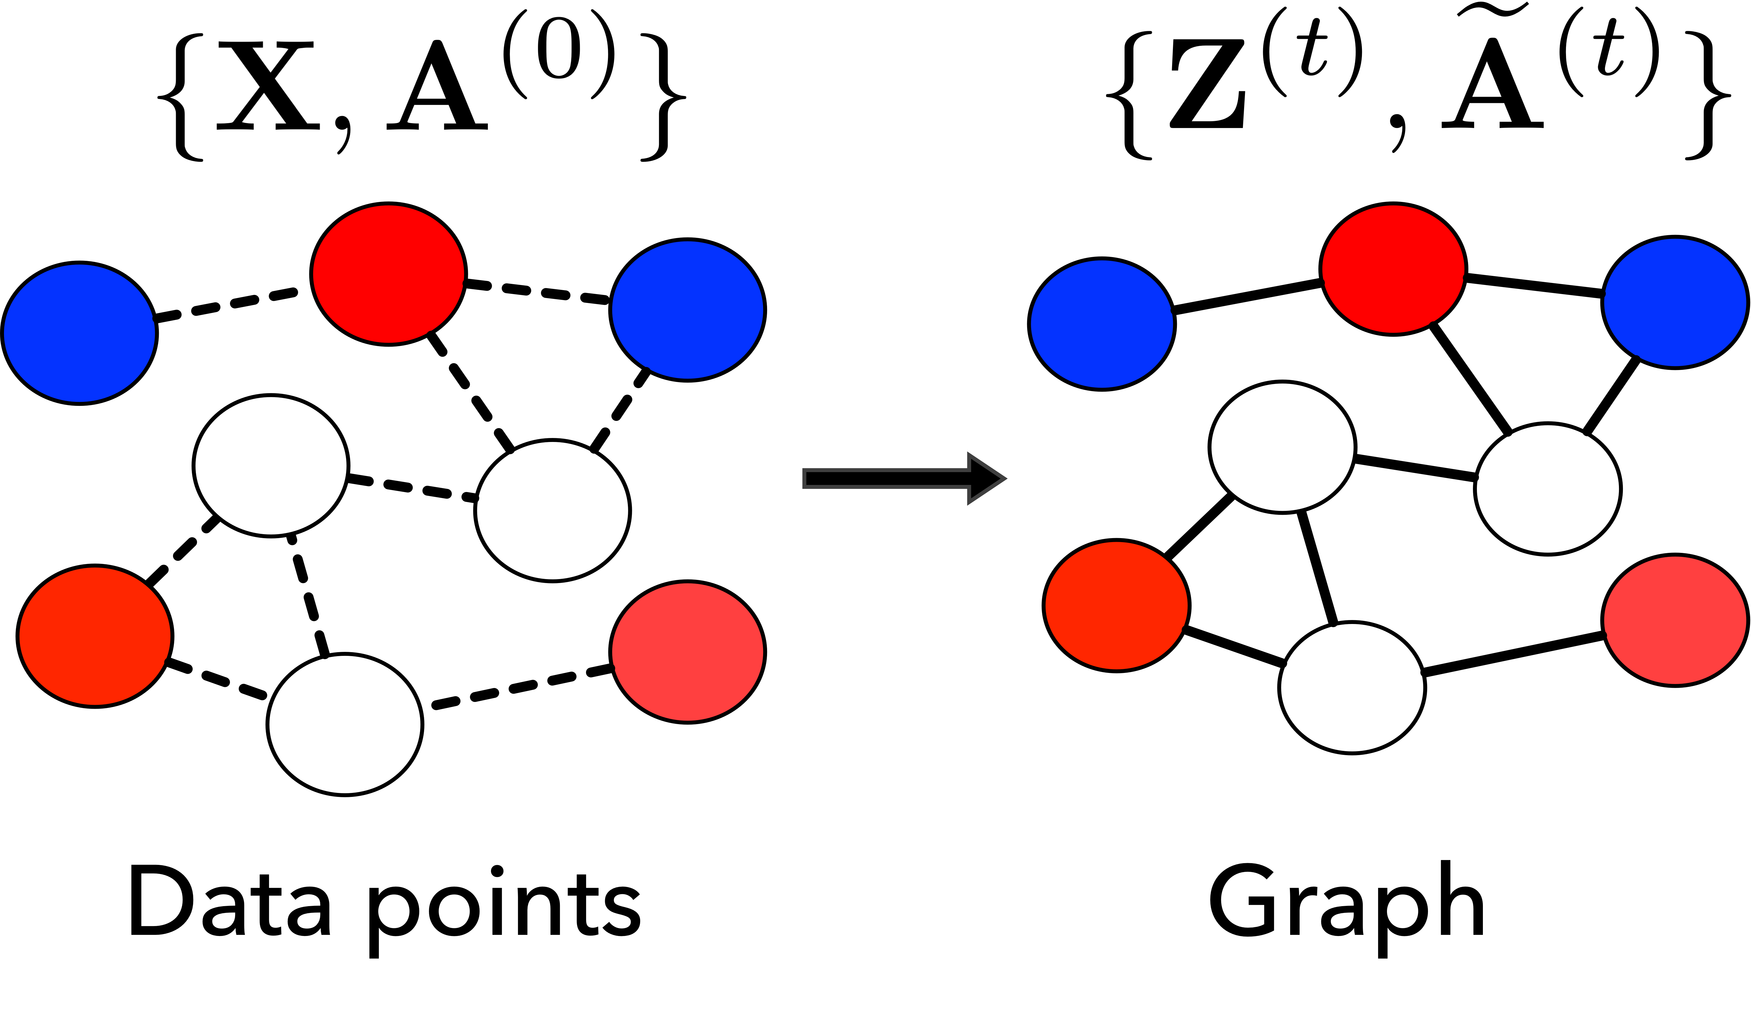
Problem Formulation
Input: a set of n objects associated with a feature matrix
and an (optional and potentially noisy) initial graph topology.
Output: an adjacency matrix and node embeddings with respect to the downstream prediction task.

Slide 4
Contributions
We propose a novel end-to-end graph learning framework (IDGL) for jointly and iteratively learning the graph structure and graph embedding.
We further propose a scalable version of IDGL, namely IDGL-Anch, which achieves linear complexity in both computational time and memory consumption with respect to the number of graph nodes.
Experimental results demonstrate the effectiveness and robustness of our models which can cope with both transductive and inductive learning.

Slide 5
Graph Structure and Embedding Learning: A Unified Perspective
A sketch of the IDGL framework
Downstream task prediction
Input data
Jointly learn the graph structure and embeddings.
Better node embeddings -> better graph structure
Better graph structure -> better node embeddings.
Dynamically stop the iterative learning procedure.
Graph structure
Graph Learner
GNN
Graph embeddings
Repeat until condition satisfied

Slide 6
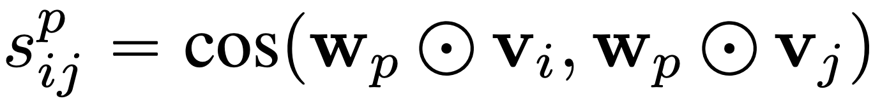
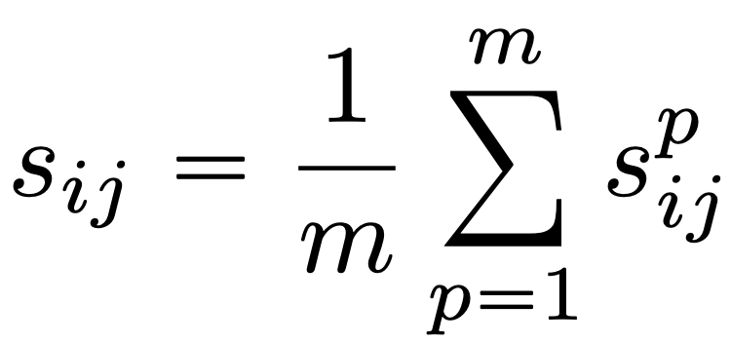
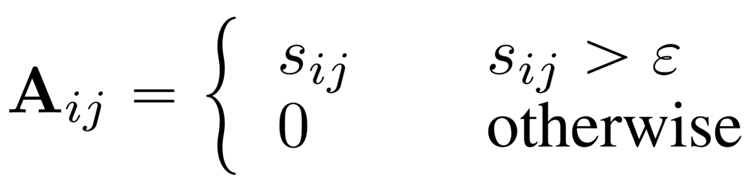
Graph Learning as Similarity Metric Learning
Multi-head weighted cosine similarity
Graph similarity metric learning.
Graph sparsification via ɛ-neighborhood.
Obtaining a symmetric sparse non-negative adjacency matrix.
Similarity for p-th
perspective
m independent weight vectors
Taking average of m similarity scores
Symmetric sparse non-negative adjacency matrix

Slide 7
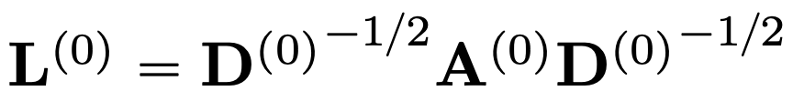
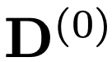
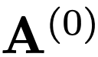
Incorporating the Initial Graph Structure
Learning a “shift” from the initial graph structure
Initial graph structure
Learned graph structure at t-th iteration
Assumption: optimized graph structure is potentially a shift from the initial graph structure.
We combine the learned graph with the initial graph.
If such an initial graph is not available, we instead use a kNN graph.
Normalized adjacency matrix
is the degree matrix of .

Slide 8
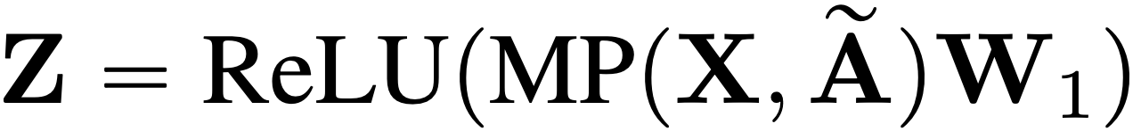
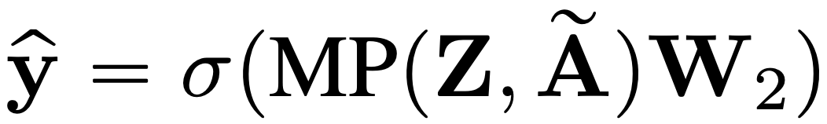
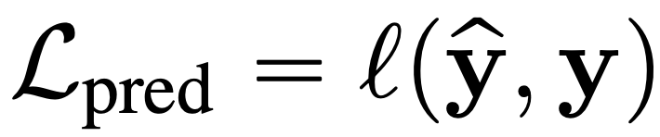
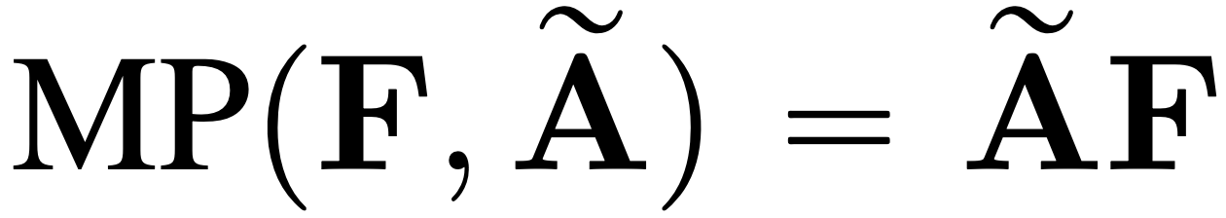
Graph Node Embeddings and Prediction
Task-dependent prediction
Normalized learned adjacency matrix
Node embedding
Task-dependent output function
Our graph learning framework is agnostic to various GNNs.
We adopt two-layered GCN in this work.
First layer: node feature -> node embedding.
Second layer: node embedding -> output space.
Raw node feature matrix
Task-dependent prediction loss
Task-dependent loss function

Slide 9
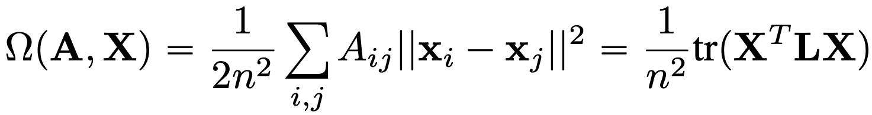
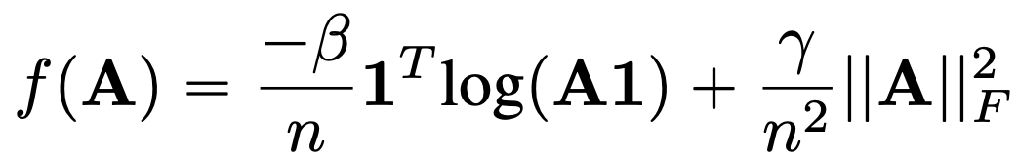
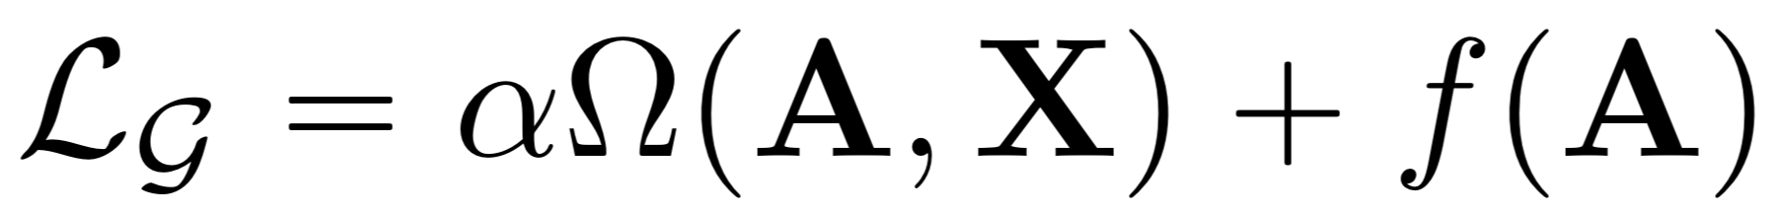
Graph Regularization
Smoothness
Control the smoothness, connectivity and sparsity of the resulting learned graph.
A is the adjacency matrix obtained through graph similarity metric learning.
Connectivity
Sparsity

Slide 10
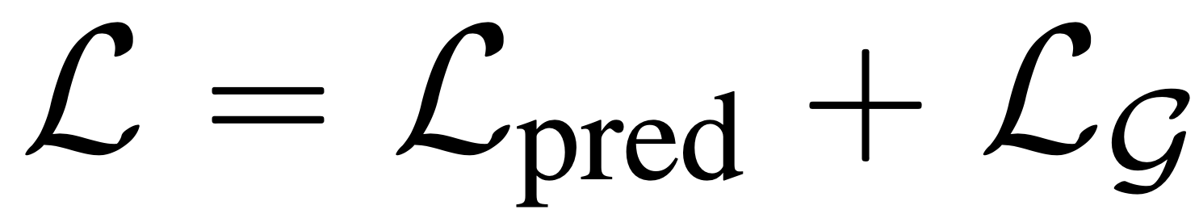
Joint Graph Structure and Representation Learning
Minimizing a joint loss function
Minimize a joint loss function combining both the prediction loss and the graph regularization loss.
Task-dependent prediction loss
Graph regularization loss

Slide 11
Revisit the Iterative Learning Idea
A sketch of the IDGL framework
Downstream task prediction
Input data
Jointly learn the graph structure and embeddings.
Better node embeddings -> better graph structure
Better graph structure -> better node embeddings.
Dynamically stop the iterative learning procedure.
Graph structure
Graph Learner
GNN
Graph embeddings
Repeat until condition satisfied

Slide 12
Iterative Deep Graph Learning Framework
The overall architecture of IDGL
A graph learning network for generating a graph topology
A graph embedding network for generating node embeddings
A graph regularization network
A prediction network for the downstream task

Slide 13
Better Scalability with IDGL-Anch
Extend IDGL to more scalable IDGL-Anch
We randomly sample a small set of s anchors from n nodes.
Some nice properties:
Node-anchor affinity matrix can be efficiently computed. O(ns)
Message passing is performed on the node-anchor bipartite graph. O(ns)
Graph regularization is performed on the anchor graph. O(ns^2)
Similarity metric function is expensive (O(n^2)).
Anchor-based approximation techniques.
Linear complexity in both computational time and memory consumption with respect to the number of graph nodes.

Slide 14
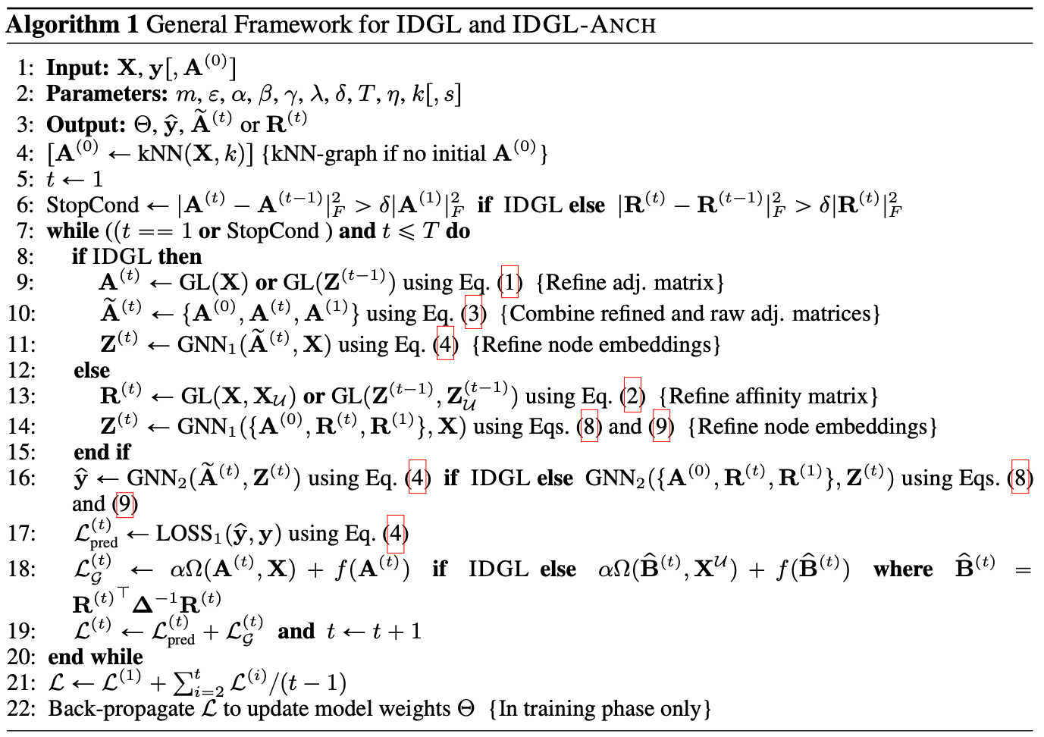
Full Algorithm
Repeatedly refining the adjacency matrix with the updated node embeddings.
Repeatedly refining the node embeddings with the updated adjacency matrix.
After all iterations, the overall loss will be back-propagated through all previous iterations to update the model parameters.

Slide 15
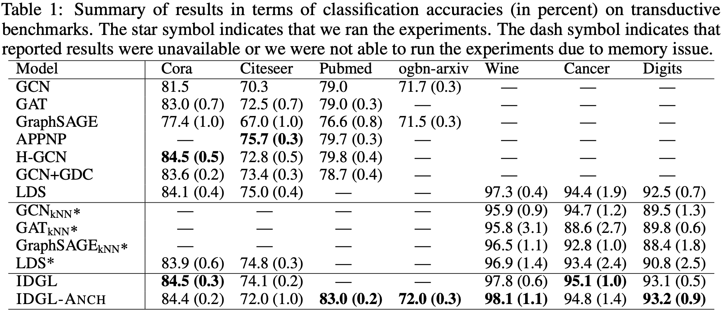
Experimental Results: Transductive Setting

Slide 16
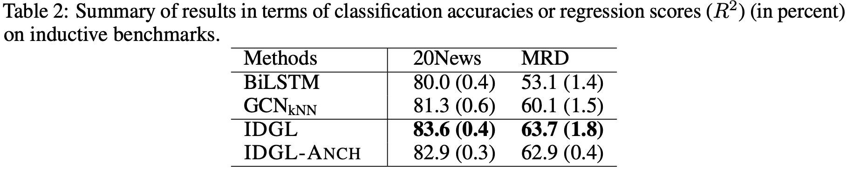
Experimental Results: Inductive Setting

Slide 17
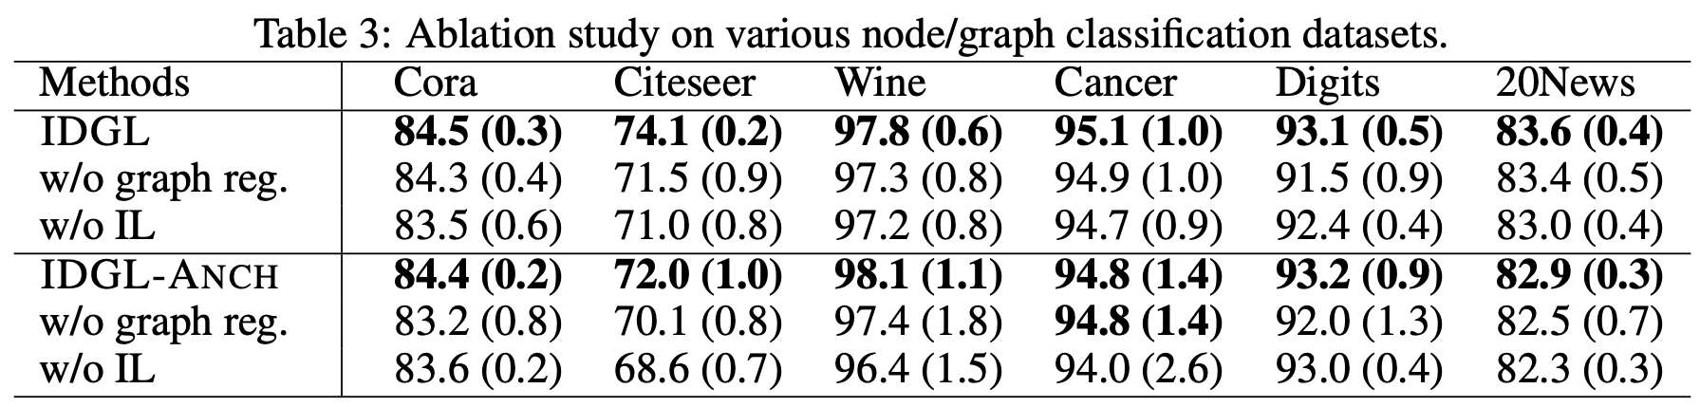
Experimental Results: Ablation Study

Slide 18
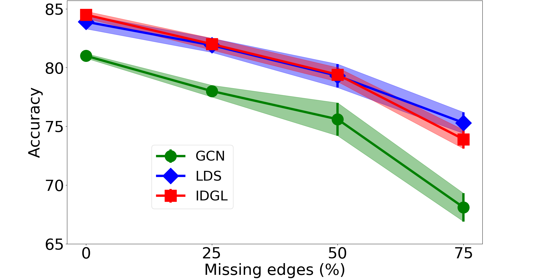
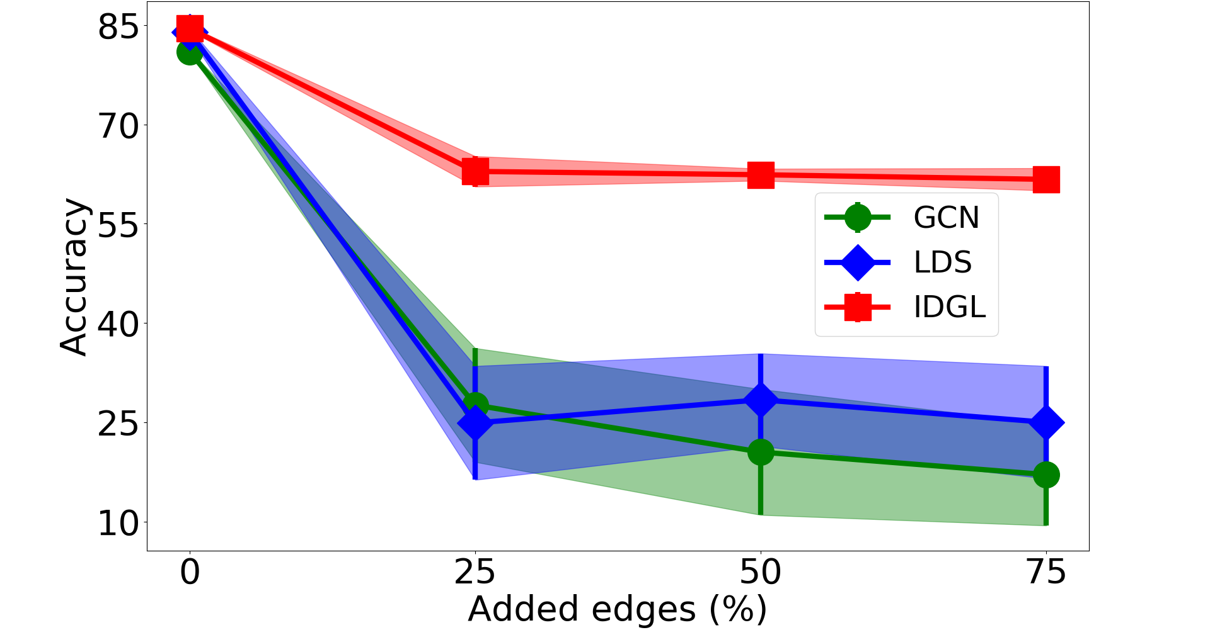
Experimental Results: Robustness Testing
Figure 1. Test accuracy (± standard deviation) in percentage for edge deletion and addition scenarios on Cora test set.

Slide 19
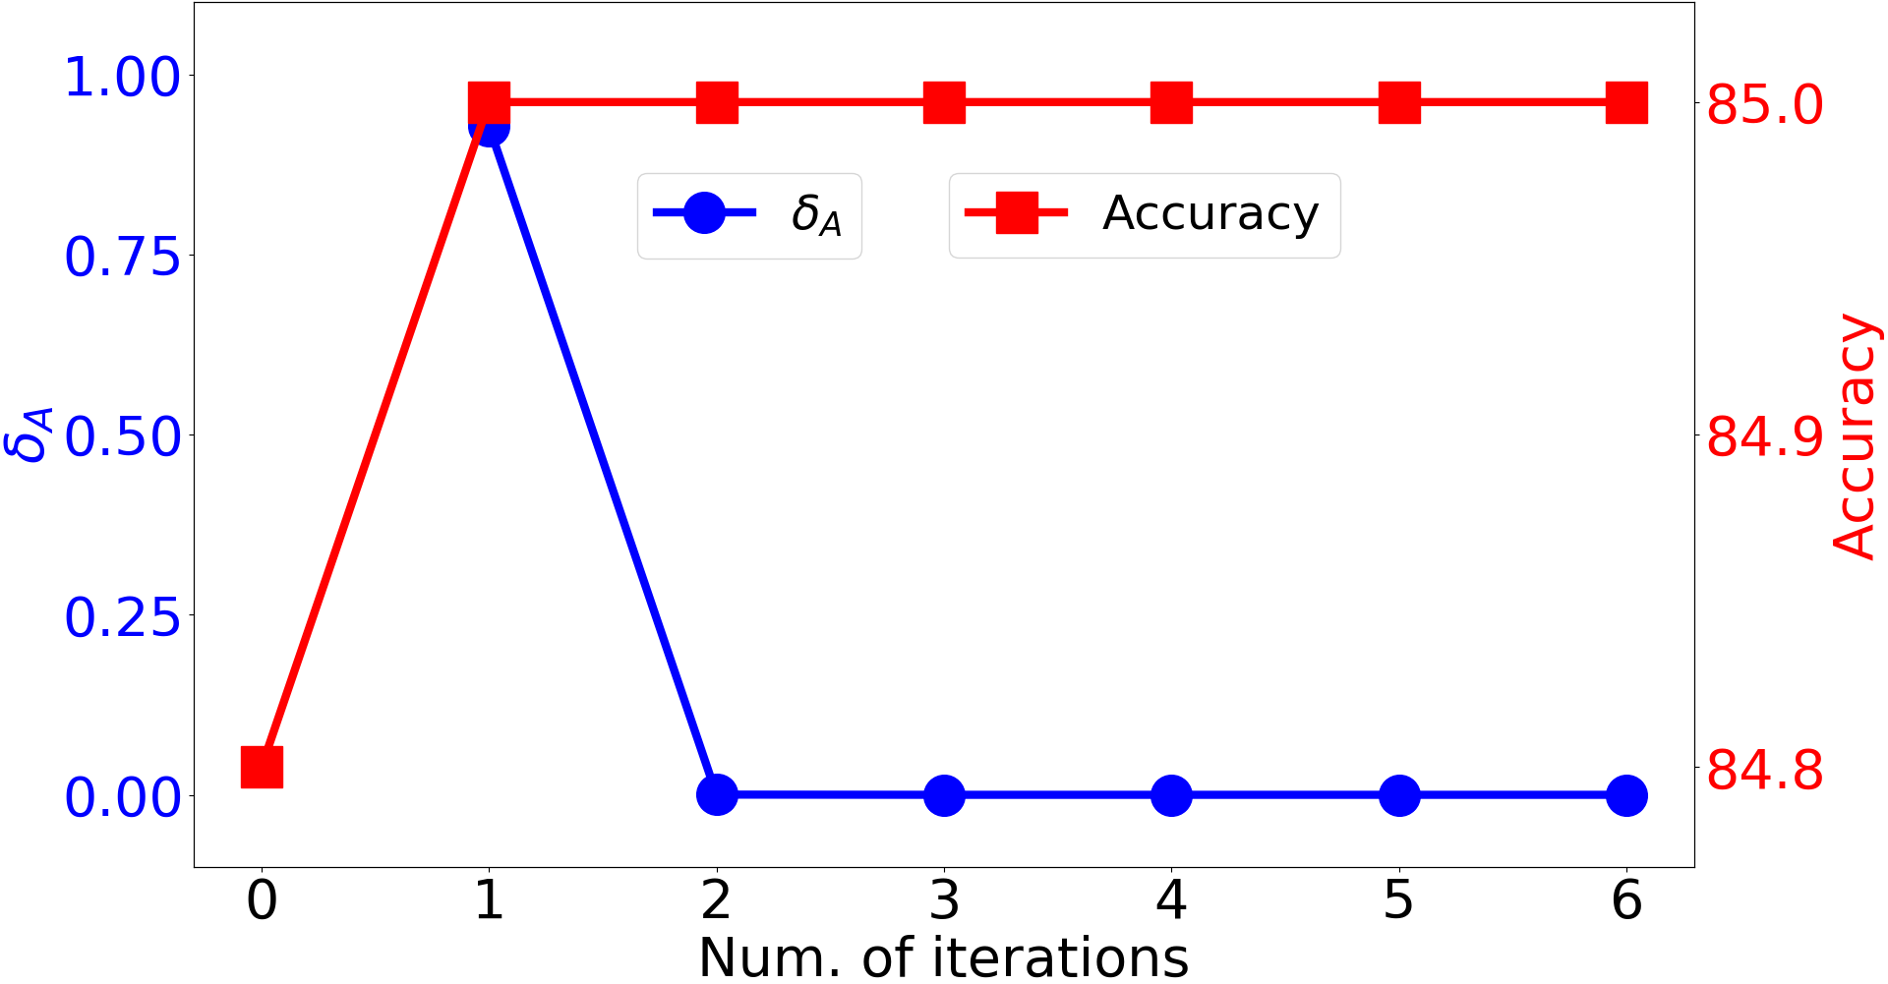
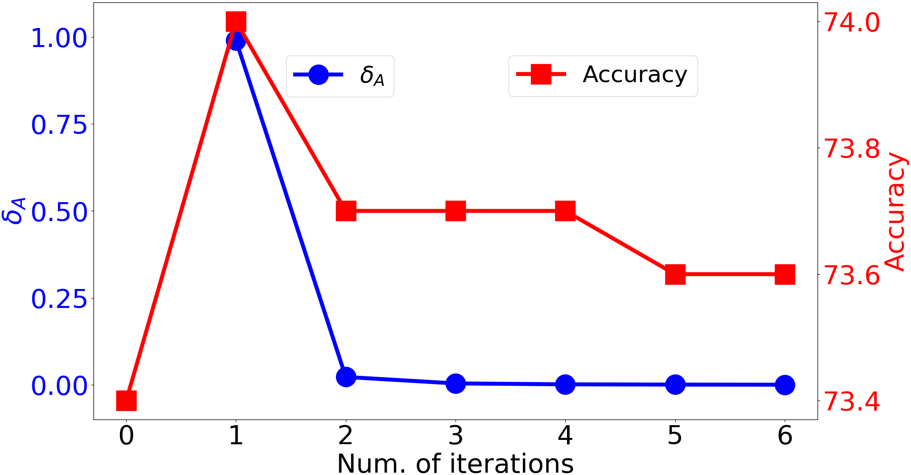
Experimental Results: Convergence Testing
(a) Cora
(b) Citeseer
Figure 2. Convergence study on Cora and Citeseer (single run results).

Slide 20
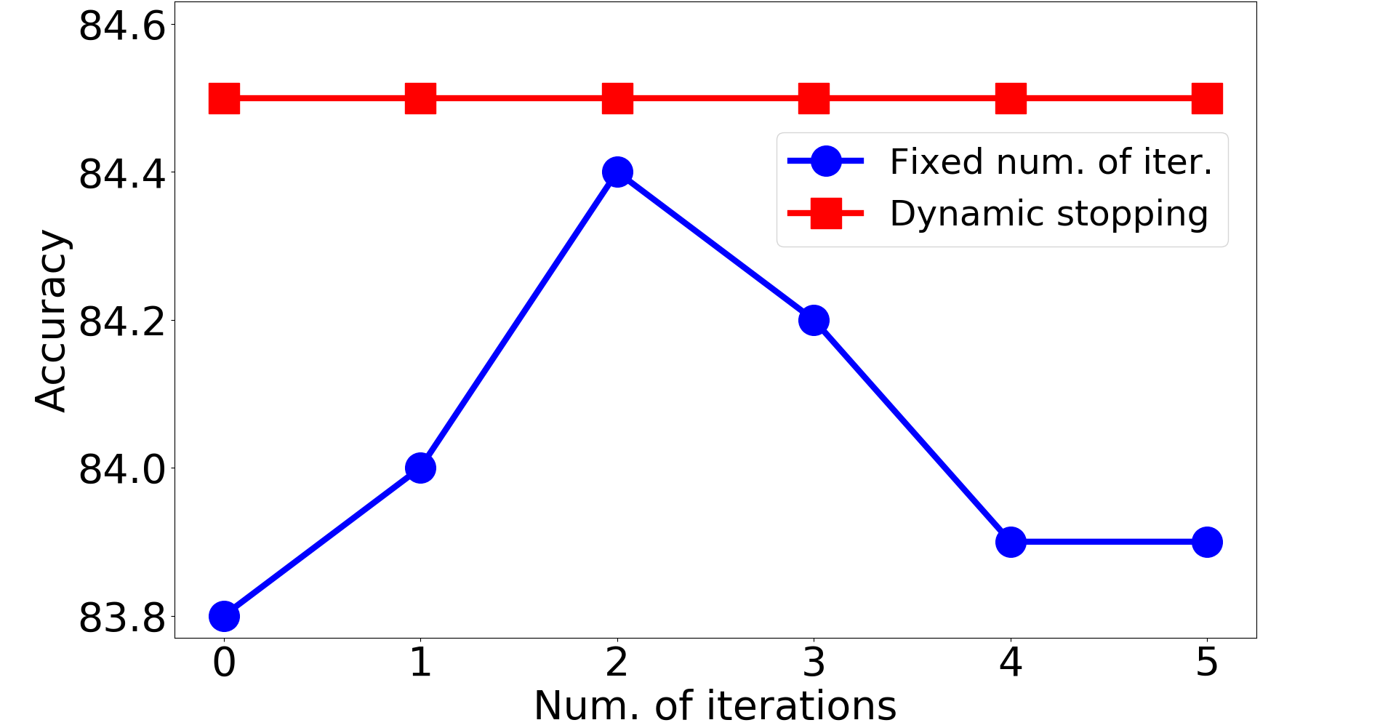
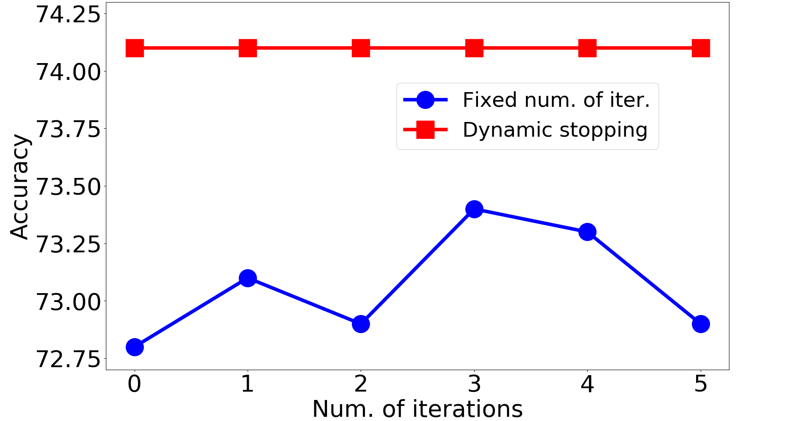
Experimental Results: Stopping Strategy
(a) Cora
(b) Citeseer
Figure 3. Performance comparison (i.e., test accuracy in %) of two different stopping strategies on Cora and Citeseer.

Slide 21
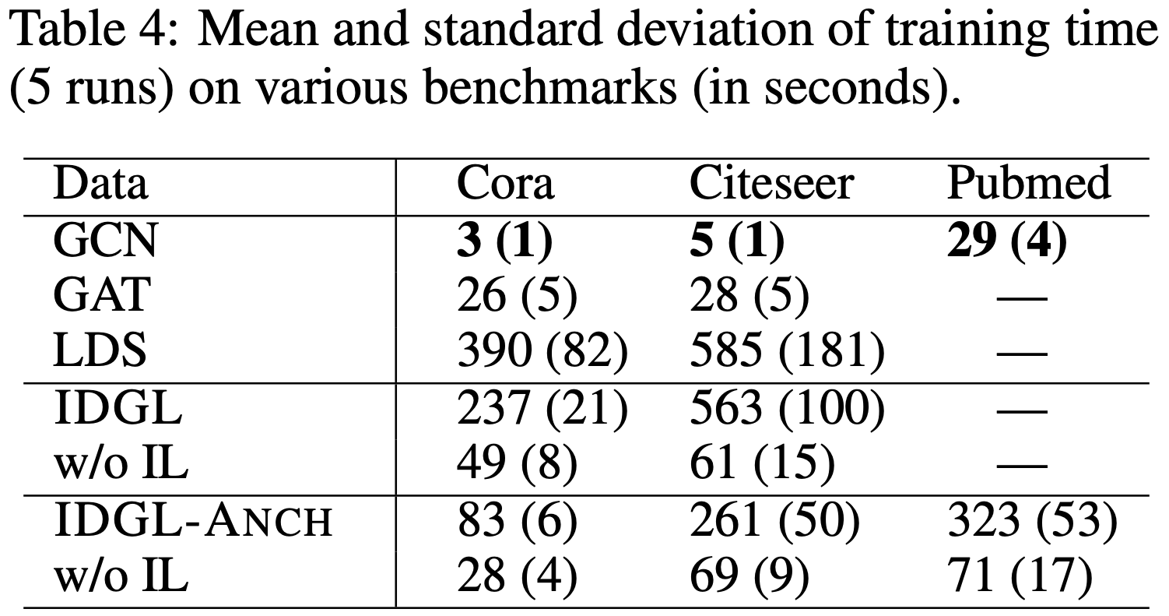
Experimental Results: Timing

Slide 22
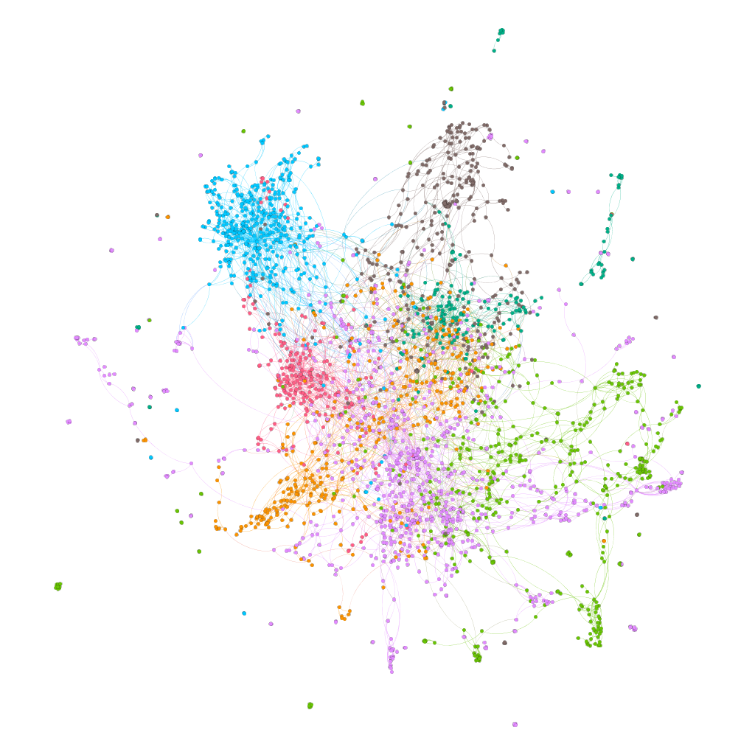
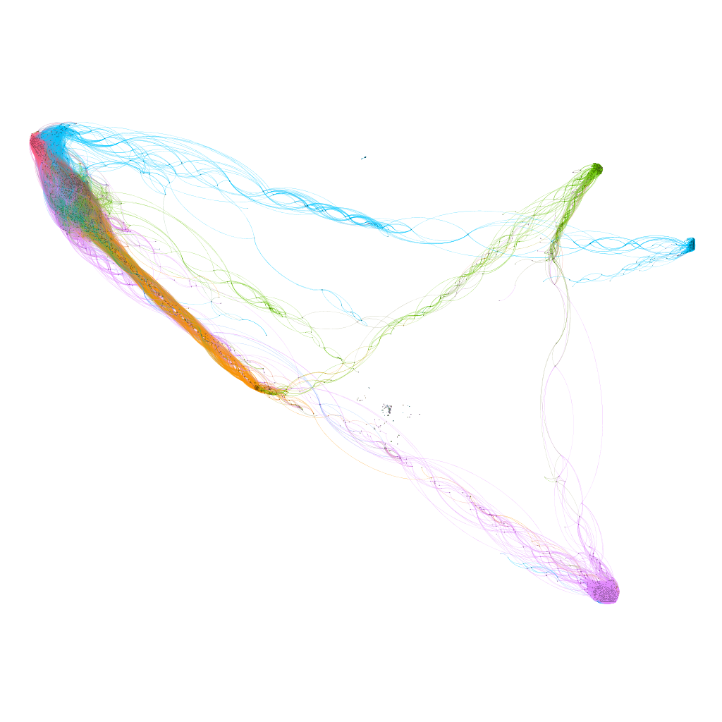
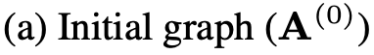
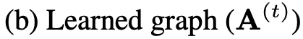
Experimental Results: Graph Visualization
Figure 4. Visualization of the initial graph and the learned graph on Cora. Colors indicate different node labels.

Slide 23
Conclusion & Future Work
We proposed a novel end-to-end graph learning framework for jointly and iteratively learning the graph structure and graph embedding that are optimized towards the prediction task at hand.
Our extensive experiments demonstrate the effectiveness of the proposed models.
Future work includes exploring more effective and scalable techniques for handling more challenging scenario where both graph topology and node feature matrix are noisy.

Slide 24
Thank you!
Code is publicly available at
https://github.com/hugochan/IDGL.

Slide 25
Backup

Slide 26
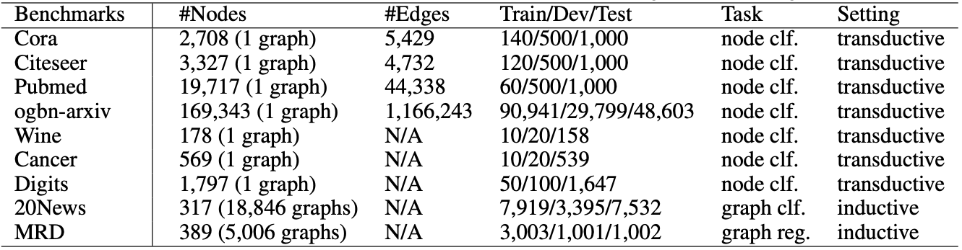
Experimental Setup
Table 5: Data statistics. (clf. indicates classification and reg. indicates regression.)
We ran our experiments 5 times with different random seeds.

